Slide 1

모바일 프로그래밍
Staxi
2012136028 김승태
2012136079 안찬웅

Slide 2
1
About STaxi
2
About Activity
Table
3
demo
4
Q & A
Notes:
Before start, I will introduce about our table of contents. I will progress presentation by this order. First part is introduction, Second part is e-r diagram, third part is relation and tables. fourth part is functions and the last part is procedures and trigger. And before finish our presentation, i will show you some demonstration of our project.

Slide 3
About staxi
STaxi
외국인들이 한국에서 택시를 이용하는데 어려움
어플리케이션을 통해 언어적 어려움을 극복하여 택시 이용 가능
어플리케이션 내에서 출발지/목적지 입력 후 자동으로 택시 호출
바가지 요금을 막기 위해 예상 요금 제공
불이익을 당한 경우 회사에 쉽게 컴플레인
Notes:
In this part, I will introduce about relations and tables of our database. Our database have 4Tables, member info, other information, board history, comment history. And each table has their attributes. The table Member info has the data of users. It have 5 keys. Member number, ID, Password, Name, NickName. The key member number is the primary key of this table. The table Other information has the sub data of users. It have 5 keys. Member Number, Email, Registerd data, age, address. The key member number is primary key. The table board history has the data of user’s activity on board. It have 5 keys. Board number, subjects, content, date, member number. The key Board number is primary key and the key member number is foreign key. It is primary key of member info. The table comment history has the data of user’s activity on comment. It have 5 keys. Comment number, content, data, member number, board number. The key Comment number is primary key of this table. And the key member number and board number is foreign key. Each key is the primary key of other information table and board history table.

Slide 4
activity
Used method
Login
Google과 연동하여 google 계정을 통한 간편 로그인
Map
Google map api를 이용한 간 간편한 길 찾기
Database
운전기사에 관한 정보를 database에 저장
Text message
- 어플리케이션 내에서 기사/관리자에게 메시지 전송
Notes:
The title of our database project is website member management. In these days, there are a lot of website. And for manager, manage user’s information is really important. To manage user’s information easily, database program is essential thing for them. This is the reason, we made website management database program.

Slide 5
demo
Demo
Notes:
This is end of our inroduction about our database. And now, I will show you about the way, our database performed.

Slide 6
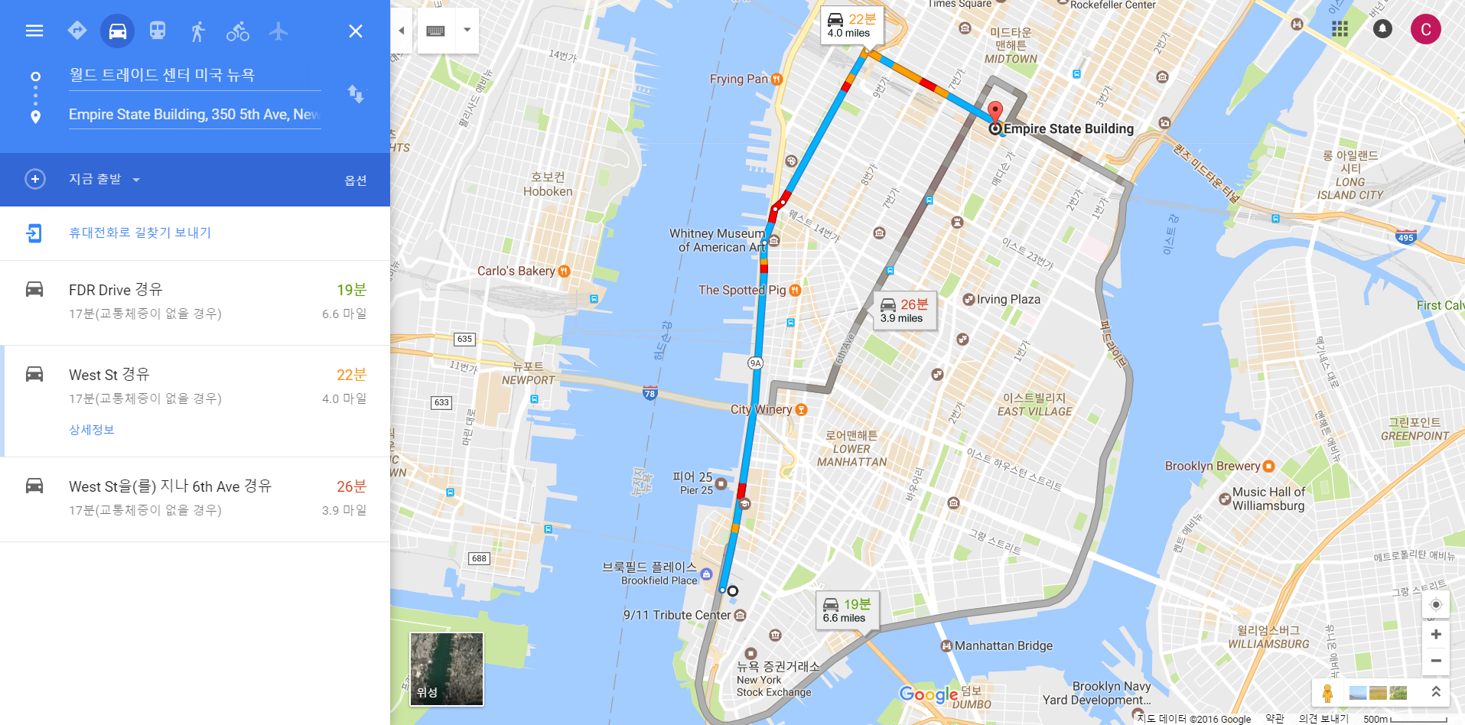
demo
웹에서의 google map과 비교
Notes:
In this part, I will introduce about relations and tables of our database. Our database have 4Tables, member info, other information, board history, comment history. And each table has their attributes. The table Member info has the data of users. It have 5 keys. Member number, ID, Password, Name, NickName. The key member number is the primary key of this table. The table Other information has the sub data of users. It have 5 keys. Member Number, Email, Registerd data, age, address. The key member number is primary key. The table board history has the data of user’s activity on board. It have 5 keys. Board number, subjects, content, date, member number. The key Board number is primary key and the key member number is foreign key. It is primary key of member info. The table comment history has the data of user’s activity on comment. It have 5 keys. Comment number, content, data, member number, board number. The key Comment number is primary key of this table. And the key member number and board number is foreign key. Each key is the primary key of other information table and board history table.

Slide 7
End
Q & A
Notes:
This is end of our inroduction about our database. And now, I will show you about the way, our database performed.

